Slide 1
Linear Regression and Generalized Linear Models
June 26, 2019
Dmitrii Pianov
Benika Hall, Yimei Zia

Slide 2
Relationship and Causality
One type of questions asked in statistics is what is the relationship between a variable and one or more covariates that are expected to be related to the interesting variable in question?
As anything in statistics, the first step is starting with the appropriate hypothesis
We can say “the variable is caused by”, or “have positive relationship with” variable or set of variable
More formally, we are building a model by trying to recover a joint probability function p(y, X), where y – variable of interest and X={x1,…,xn} – a set of explanatory variables (covariates)
Correlation does not imply causation!

Slide 3
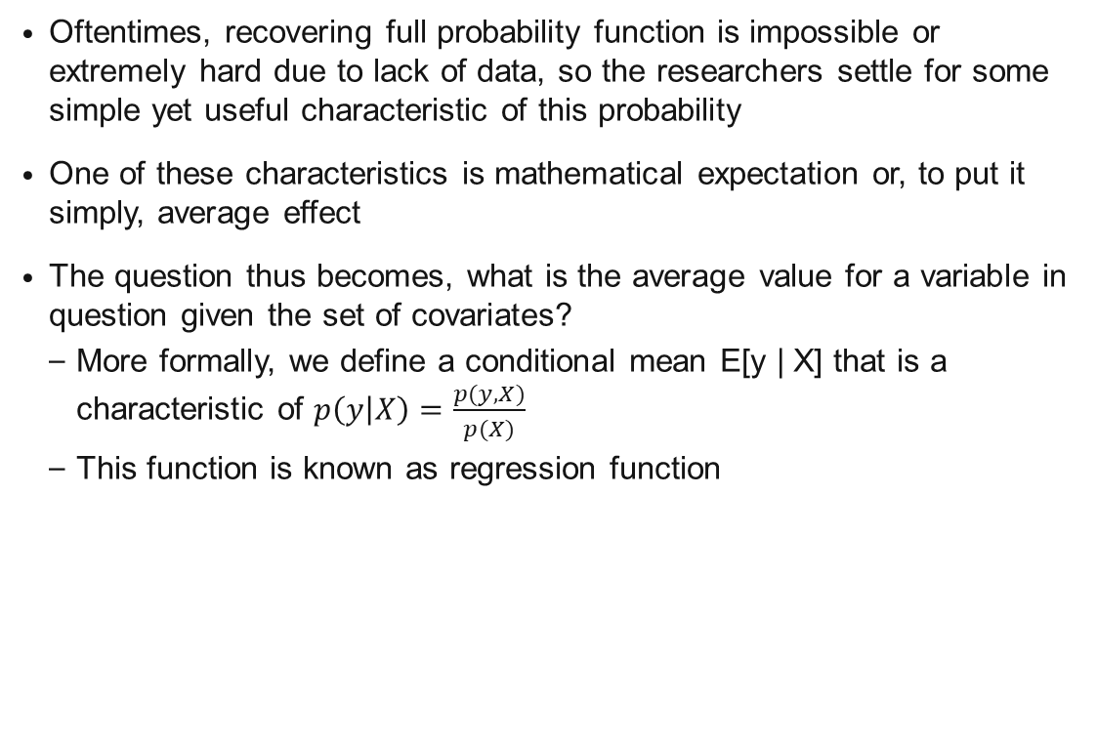
Relationship and Causality cont.
Oftentimes, recovering full probability function is impossible or extremely hard due to lack of data, so the researchers settle for some simple yet useful characteristic of this probability
One of these characteristics is mathematical expectation or, to put it simply, average effect
The question thus becomes, what is the average value for a variable in question given the set of covariates?
More formally, we define a conditional mean E[y | X] that is a characteristic of $p\left(y | X\right)=\frac{p(y, X)}{p(X)}$
This function is known as regression function

Slide 4
Examples
Education (how having good grades at school impacts lifetime earnings)
Human rights (how position of women in household impact child's health and education)
Economics (the economics of brushing teeth)
Psychology (how brain reacts on different types of humor)

Slide 5
Agenda
Introduction to linear regression
Prediction and Inference
Assumptions of regression model
Regression Analysis
Logistic Regression
Generalized Linear Models (GLMs)

Slide 6
Introduction to Linear Regression

Slide 7
Overview
Linear regression is often used to explore relationships between a scalar response and a set of covariates.
Basic idea is to examine two things
Are the predictor variables good at predicting the dependent variable?
Which variables are significant predictors of the dependent variable?
Regression relies on a set of assumption that are required in order to properly estimate the linear model.

Slide 8
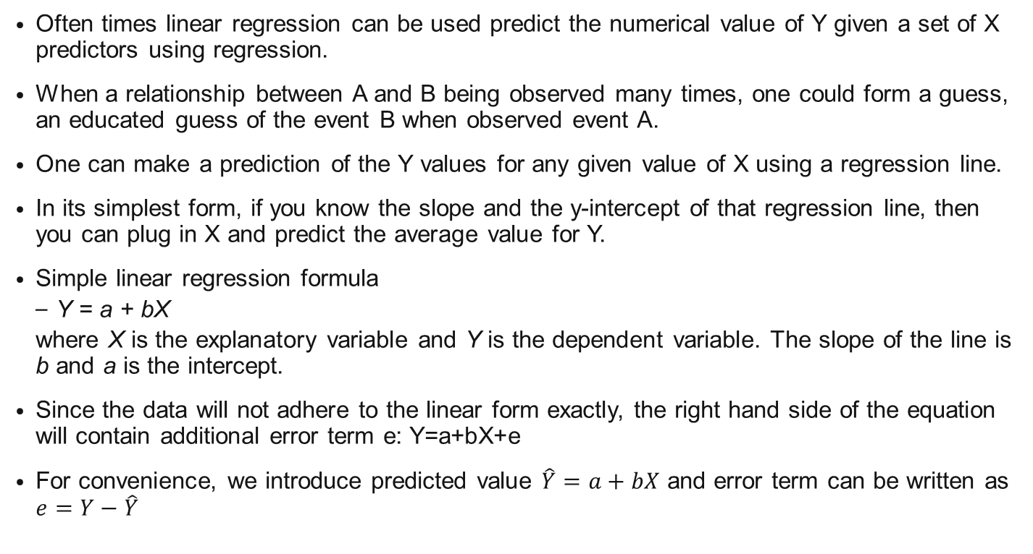
Prediction and Regression
Often times linear regression can be used predict the numerical value of Y given a set of X predictors using regression.
When a relationship between A and B being observed many times, one could form a guess, an educated guess of the event B when observed event A.
One can make a prediction of the Y values for any given value of X using a regression line.
In its simplest form, if you know the slope and the y-intercept of that regression line, then you can plug in X and predict the average value for Y.
Simple linear regression formula
Y = a + bX
where X is the explanatory variable and Y is the dependent variable. The slope of the line is b and a is the intercept.
Since the data will not adhere to the linear form exactly, the right hand side of the equation will contain additional error term e: Y=a+bX+e
For convenience, we introduce predicted value $\hat{Y}=a+bX$ and error term can be written as $e=Y−\hat{Y}$

Slide 9
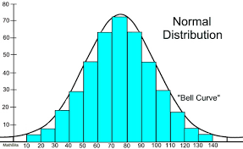
Assumptions of a Regression Model
No or little multi-collinearity
This is to say that independent variables are not correlated, or say: one could not predict one independent variable from another independent variable.
Linearity of the relationship between dependent and independent variables
Linear relationship between A & B: As A increase, B increase or decrease.
Statistical independence of the errors
It is to say that when you use the data to do regression, each row of the data should not be correlated.
Error term is normally distributed
The error term distribution is a bell shaped curve.
No heteroscedasticity
Predictors are not correlated with error
https://mathbitsnotebook.com/Algebra2/Statistics/STnormalDistribution.html

Slide 10
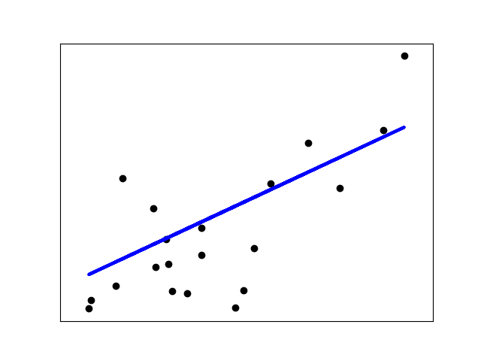
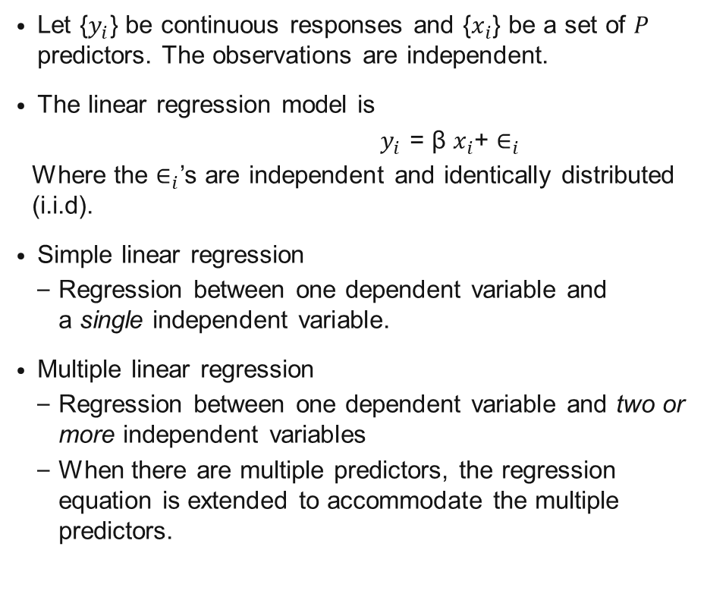
Linear Regression
Let {$y_{i}$} be continuous responses and {$x_{i}$} be a set of $P$ predictors. The observations are independent.
The linear regression model is
$y_{i}$ = β $x_{i}$+ $∈_{i}$
Where the $∈_{i}$’s are independent and identically distributed (i.i.d).
Simple linear regression
Regression between one dependent variable and a single independent variable.
Multiple linear regression
Regression between one dependent variable and two or more independent variables
When there are multiple predictors, the regression equation is extended to accommodate the multiple predictors.
https://scikit-learn.org/stable/modules/linear_model.html

Slide 11
Linear Regression Estimation

Slide 12
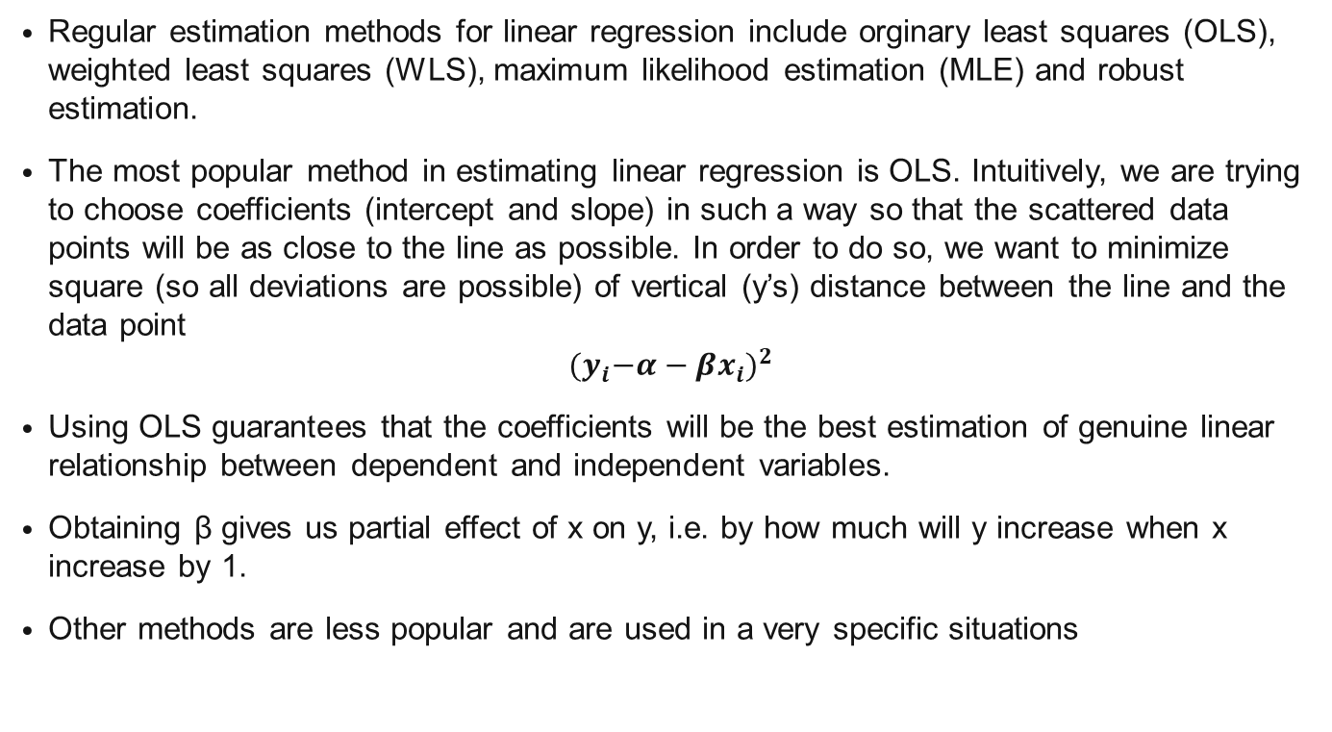
Linear Regression – Estimation
Regular estimation methods for linear regression include orginary least squares (OLS), weighted least squares (WLS), maximum likelihood estimation (MLE) and robust estimation.
The most popular method in estimating linear regression is OLS. Intuitively, we are trying to choose coefficients (intercept and slope) in such a way so that the scattered data points will be as close to the line as possible. In order to do so, we want to minimize square (so all deviations are possible) of vertical (y’s) distance between the line and the data point
$${{(y}_{i}−α−βx_{i})}^{2}$$
Using OLS guarantees that the coefficients will be the best estimation of genuine linear relationship between dependent and independent variables.
Obtaining β gives us partial effect of x on y, i.e. by how much will y increase when x increase by 1.
Other methods are less popular and are used in a very specific situations

Slide 13
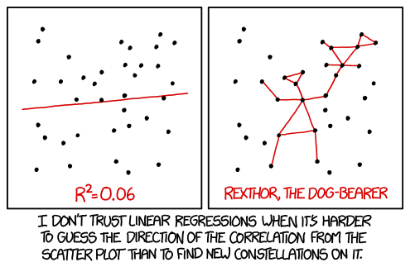
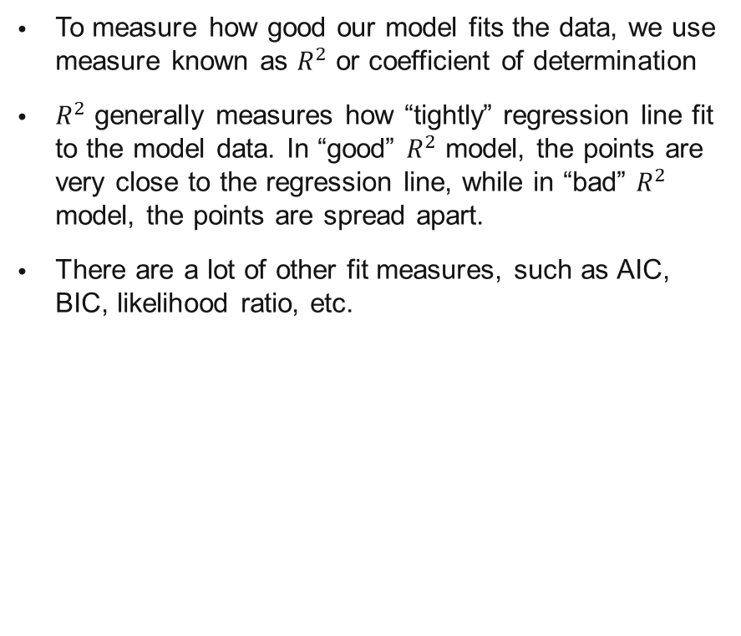
Model fit statistics
To measure how good our model fits the data, we use measure known as $R^{2}$ or coefficient of determination
$R^{2}$ generally measures how “tightly” regression line fit to the model data. In “good” $R^{2}$ model, the points are very close to the regression line, while in “bad” $R^{2}$ model, the points are spread apart.
There are a lot of other fit measures, such as AIC, BIC, likelihood ratio, etc.

Slide 14
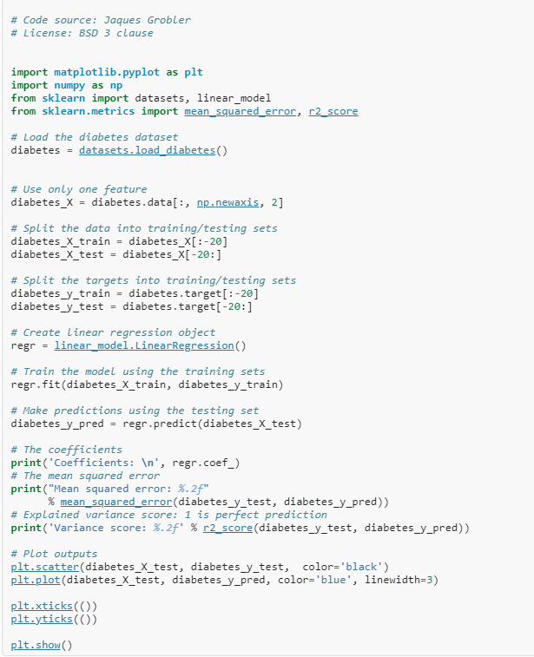
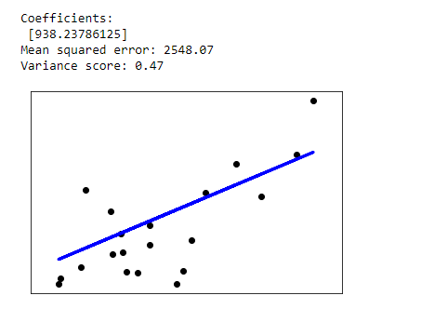
Scikit-Learn Linear Regression Example
https://scikit-learn.org/stable/modules/linear_model.html

Slide 15
Logistic Regression

Slide 16
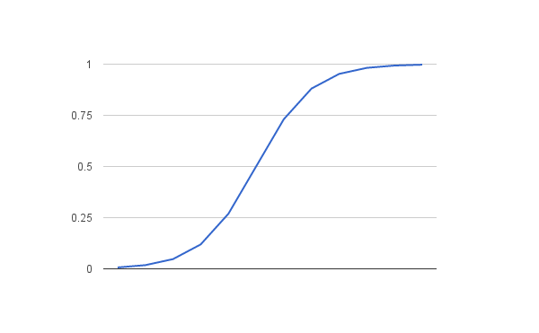
Binary Logistic Regression
In our work, logistic regression is often used as binary classification algorithm used to assign observations to a discrete set of labels or classes.
Unlike linear regression which has a continuous response, logistic regression transforms its output using the logistic sigmoid function to return a probability value which can then be mapped to two or more discrete classes.
Example comparison
Linear regression can be used to predict to the numerical values of a student‘s test score on a scale 1-100.
Logistic regression can be used to predict whether a student passed or failed. We can also view the probability scores of the model’s classification.
Logistic function
https://machinelearningmastery.com/

Slide 17
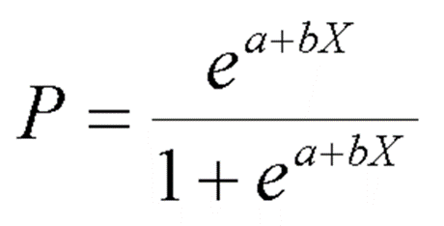
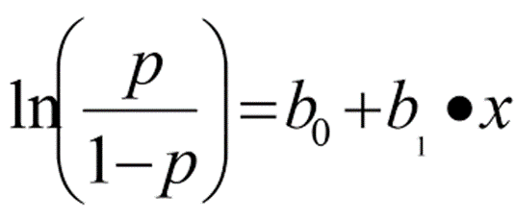
Binary Logistic Regression
Often used to predict the relationship between predictors and a predicted variable where the dependent variable is binary.
Requires that there be little to no multi-collinearity.
The binary logistic model can be used to estimate the probability of a binary response which is based on one or more predictor variables.
The ln symbol refers to a natural logarithm and b0 + b1X is our familiar equation for the regression line. P can be computed from the regression equation also.
So, if we know the regression equation, we could, theoretically, calculate the expected probability that Y = 1 for a given value of X.
In logistic regression, a complex formula is required to convert back and forth from the logistic equation to the OLS-type equation. The logistic formulas are stated in terms of the probability that Y = 1, which is referred to as pˆ . The probability that Y is 0 is 1 - pˆ .

Slide 18
Logistic Regression Estimation

Slide 19
Logistic Regression: Estimation
The regression coefficients are usually estimated by maximum likelihood estimation
Maximum likelihood estimation (MLE) is a statistical method for estimating the coefficients of a model.
The likelihood function (L) measures the probability of observing the particular set of dependent variable values (p₁, p₂, ..., p_{n}) that occur in the sample.
Likelihood is a general and versatile method of estimation.
Very efficient when there are large samples
Drawback – It is computationally intensive in complex situations

Slide 20
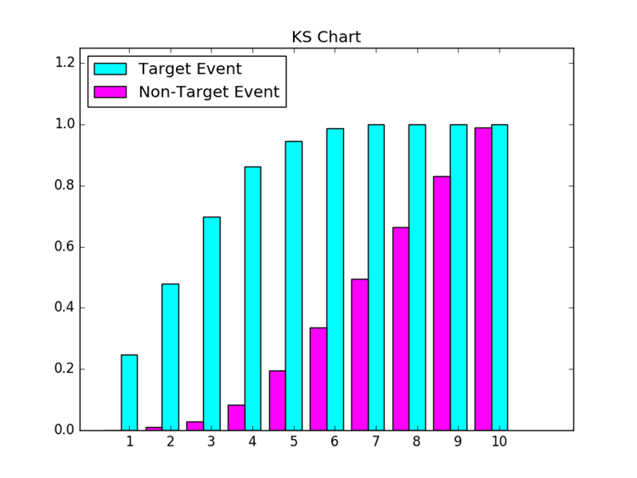
Metrics to assess Logistic Regression
Some metrics we use to assess logistic regression performance are Kolmogorov-Smirnov statistic and Gains table.

Slide 21
Example
Suppose you would like to treat yourself an expensive gift (a new car, phone, gaming console, etc.), but you don’t have enough money to buy it
You would like to borrow some money from the bank that you know you would repay later (your grandma promised you a gift to your birthday several months away).
Banks operate on belief that they can forecast the likelihood of a person repaying a loan based on the credit related information (income, previous credit history, etc.)
Chances are, young people will not have any such information to provide, thus prohibiting them from receiving a loan.
Bank offers you alternative solution and promises to give you money if you provide information from your social network.
Try to build a model and help bank to find the relevant information that will help it make a credit decision. Use artificial social network data we provided for the camp.

Slide 22
Generalized Linear Models (GLMs)

Slide 23
Generalized Linear Models
We handle a variety of data types with different distributional properties such as:
Continuous responses with non-normal data
Categorical, binary, count data, …
In these cases, the linear regression model is not suitable for all of these data types
Generalized Linear Model offers a universal framework for handling these multiple types of data.
When using GLMs, it assumes that the response y belongs to an exponential family such as normal, binomial, multinomial, gamma or Poisson distribution.
In this case, we do not need to transform the response to have an approximately normal distribution.

Slide 24
Wrap up
Purpose and scope. What kind of problems you face when you use linear models
Linear regression
Logit
GLM

Slide 25
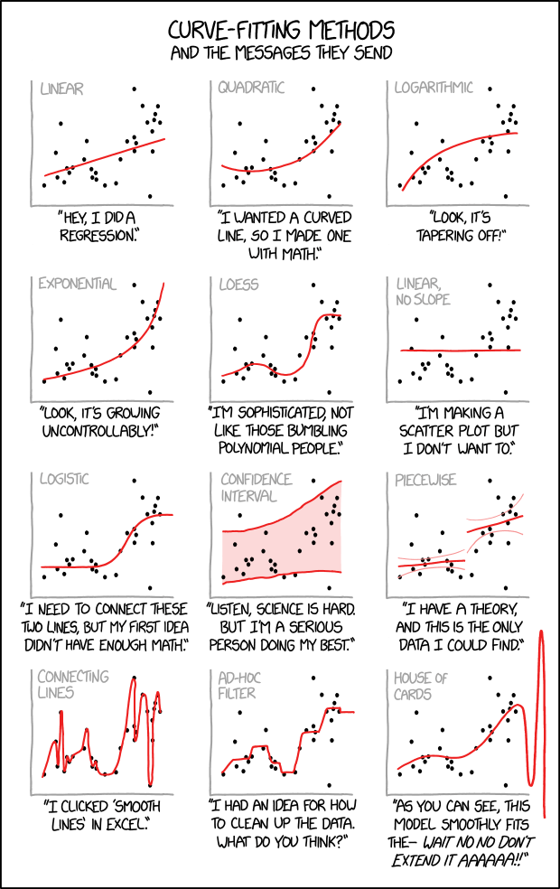

Slide 26
Questions

